Slide 1

Federal
Legislative and Regulatory Update

Slide 2
Workforce
Innovation & Opportunity
Act
AGENDA
Overview
Regulatory Update
Legislative Update

Slide 3

Changes In Our World
Change is Inevitable – Growth is Optional
“It is not the strongest of the species that survive,
nor the most intelligent,
but the ones most responsive to change”.
Charles Darwin
47th Annual Northwest Career Colleges Federation Conference
Thursday, May 19, 2016

Slide 4
Changes In Our World
EMBRACE IT AND ENGAGE
The most difficult time is the transition from
Doing what we have been doing, to
Doing what needs to be done…NOW!!!!
47th Annual Northwest Career Colleges Federation Conference
Thursday, May 19, 2016

Slide 5
Higher Education Today
The Economic Downturn Has Effected
ALL of Higher Education
Decrease in student enrollments in every sector of higher education – including the private and public sectors.
The unparalleled rise of student debt exceeding $1 Trillion.
Decreased State support of public higher education.
Heightened regulatory oversight at all levels!
47th Annual Northwest Career Colleges Federation Conference
Thursday, May 19, 2016

Slide 6
Our Sector of Higher Education Today
The For-profit Community Continues To Be Targeted
Sustained demonization and distortion of our contributions to higher education.
Rhetorical tone has grown more bombastic, hyperbolic and imbalanced.
Contracture and closure of school groups – especially, but not exclusively, within publically-traded subsectors has given rise to new attacks and calls for additional reform.
47th Annual Northwest Career Colleges Federation Conference
Thursday, May 19, 2016

Slide 7
What’s Trending Now?
New Opportunities = New Ways of Engaging
Shift towards a performance-based and outcomes-driven system of higher education
Increased disclosures by all institutions
  GE impacting all of higher education
  College Scorecard
  Accreditation Standards
47th Annual Northwest Career Colleges Federation Conference
Thursday, May 19, 2016

Slide 8
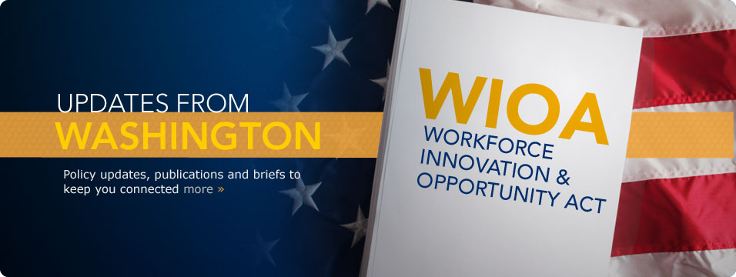
http://www.nawb.org

Slide 9
History of Workforce Development in the U.S.
1. Wagner Peter Act of 1933
Established Nationwide system of Public Employment offices that were created for the states to cooperate and promote employment.
2. Manpower Development Training Act of 1962
Provided major Federal funding to Departments of Health, Education and Welfare to improve Technical Training of unemployed and underemployed labor in postwar period.
3. Rehabilitation Act of 1973
Emphasized Training for Vocational Rehabilitation, Independent Living, and Client Assistance. Prohibited discrimination on the basis of a disability.
47th Annual Northwest Career Colleges Federation Conference
Thursday, May 19, 2016

Slide 10
History of Workforce Development in the U.S.
4. Comprehensive Employment and Training Act of 1973 (CETA)
Consolidates all existing Federal Job Training Programs focused on unemployment and out of high school youths provided training and full-time jobs in public service. The Act provided funds to State and local governments through Federal Grants.
5. Job Training and Partnership Act of 1982 (JTPA)
Used Federal Funding to prepare youth and unskilled adults, and dislocated workers for entry into the workforce.
6. Workforce Investment Act of 1998 (WIA)
Federal legislation enacted and sought to include business through Workforce Investment Boards (WIB) that would be chaired by Private Sector Members of the local community.
47th Annual Northwest Career Colleges Federation Conference
Thursday, May 19, 2016

Slide 11
History of Workforce Development in the U.S.
7. Workforce Innovations and Opportunity Act of 2014 (WIOA)
  Effective July 1, 2015 and seeks to consolidate Job Training Programs under the Workforce Investment Act of 1998.
  Streamlines the services from 3 levels (Core, Intensive, and Training) into a single process.
  Has performance requirements for all Eligible Training Providers approved to offer needed training.
47th Annual Northwest Career Colleges Federation Conference
Thursday, May 19, 2016

Slide 12
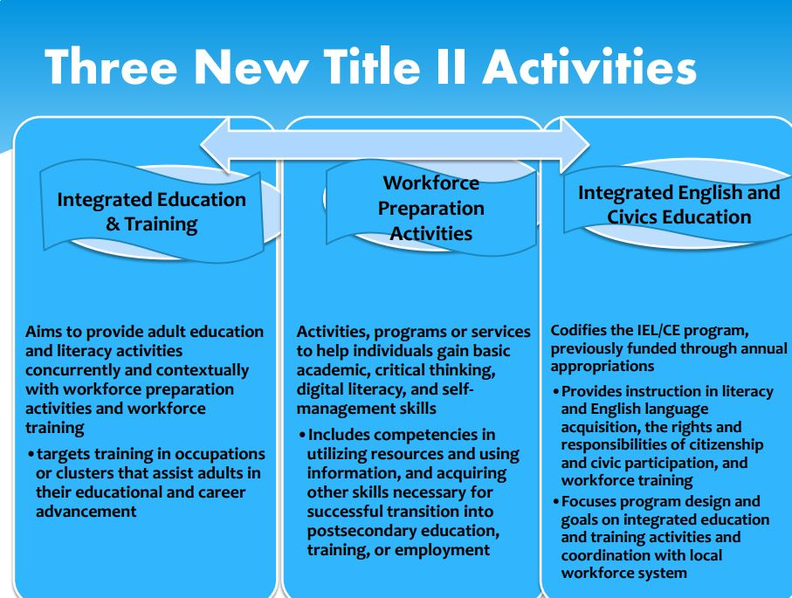
What Does It Do?

Slide 13
What Does It Mean?
Key Changes to WIOA Can Benefit Your Institution!
When combined with the trend for decreased funding for public institutions at the state level and the provisions of GE that will impact community colleges, our opportunities to educate more citizens increases
We need to have representation from our institutions on State-wide WIOA Boards, County WIBS, LWIBS
47th Annual Northwest Career Colleges Federation Conference
Thursday, May 19, 2016

Slide 14
What Can We Do Now?
Focus on Outcomes
Not to meet the metrics but to BEAT the metrics
Take another look at what skills (hard and soft) Employers are demanding in the workforce (NACE)
What percentage of time do we teach skills related to success in the academic environment
What percentage of time do we teach skills related to success on the job?
47th Annual Northwest Career Colleges Federation Conference
Thursday, May 19, 2016

Slide 15
Tell Our Story
Private Colleges and Career Schools have existed for centuries and are not going away!
Our sector has the gift and capacity for re-invention…
We have the clarity and power to quickly embrace personal and organizational change….. And Love It!
We are the bridge between aspiration and opportunity…
We change lives!
47th Annual Northwest Career Colleges Federation Conference
Thursday, May 19, 2016

Slide 16
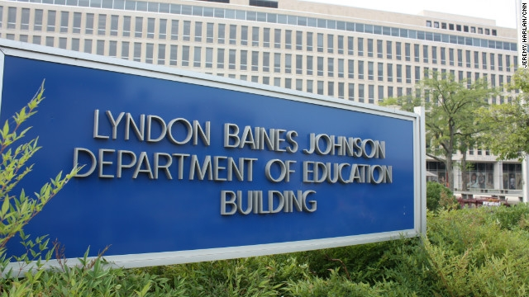
REGULATORY UPDATE

Slide 17
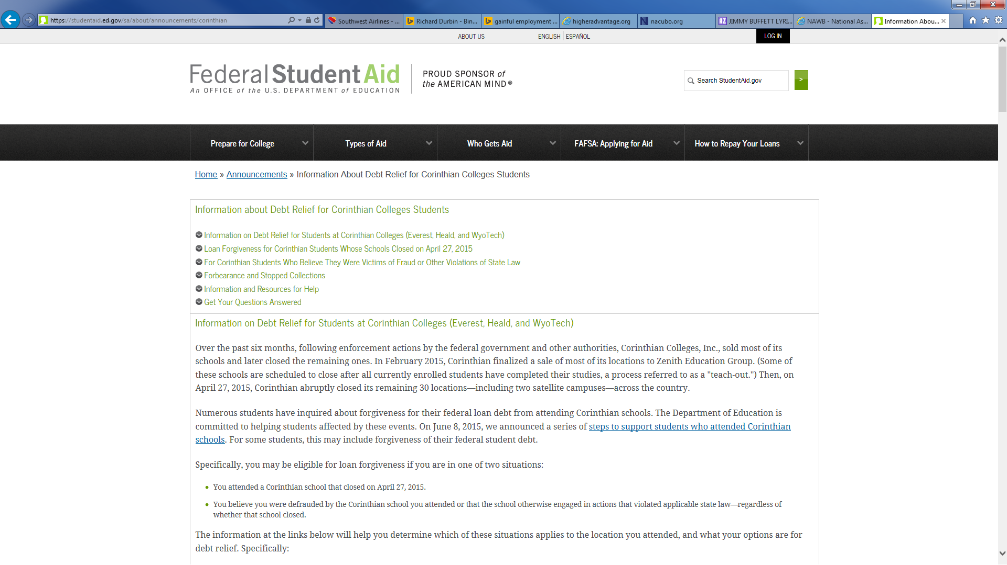
Borrower Defense to Repayment

Slide 18
Borrower Defense to Repayment
Borrower Defense to Repayment
Students who attended a school who believe they were defrauded or that their school otherwise violated applicable state law may be eligible for discharge (loan forgiveness).
This type of loan forgiveness is called “borrower defense to repayment,” sometimes abbreviated to “borrower defense.”
47th Annual Northwest Career Colleges Federation Conference
Thursday, May 19, 2016

Slide 19
Borrower Defense
Issue Papers
1-3
Financial Responsibility
Although consensus was withheld on Issue Papers 1-3
Major Concerns
are evident throughout the proposals!
Issue Paper
5
Closed School Discharge
Issue Paper
10

Slide 20
Borrower Defense to Repayment
Issue Papers 1-3: Borrower Defense
Proposal:
Creates a new regulatory section that establishes for borrower defense to repayment a Federal standard, limitations period, and processes for borrower-initiated claims, claims initiated by the Secretary, investigation and response for institutions, and final determinations.
Key Components:
Redefines Misrepresentation – making it easier for advocates to claim misrepresentation;
Establishes a Duel Process – provides for borrower defenses based upon amounts owed and amounts previously collected;
Determinations Are Based Upon a Preponderance of the Evidence – minimal threshold;
Judgments For Several Categories – individual, class, or government agency; and
Multiple Types of Findings – favorable contested judgments, breach of contract, and substantial misrepresentation.
47th Annual Northwest Career Colleges Federation Conference
Thursday, May 19, 2016

Slide 21
Borrower Defense to Repayment
Issue Paper 5: Financial Responsibility
Proposal:
To amend the general financial responsibility standards in Subpart L to include actions and events that indicate or signal that (1) a school is likely to have to pay borrower defense claims, and (2) a school’s ability to pay claims or continue its participation in the title IV programs is compromised.
These actions and events would trigger a requirement that the school submit a LOC based on prior repayments or for an amount that is not less than 10%, for each action/event, of the amount of title IV, HEA program funds received by the school during the most recently completed award year.
The Secretary may accept cash or agree to a set aside (reserve fund) in lieu of a LOC but for an equivalent amount. We are making conforming changes to Subpart G to update references in current regulations to refer as appropriate to Subpart L and to address the scope of appeals of financial responsibility determinations made under these revised regulations.
47th Annual Northwest Career Colleges Federation Conference
Thursday, May 19, 2016

Slide 22
Borrower Defense to Repayment
Issue Paper 5: Financial Responsibility
Proposal (continued):
In addition, the proposal would add to the reporting and disclosure provisions a requirement that a school would have to warn enrolled and prospective students a) of any requirement to post a letter of credit to the Department or b) if it has poor repayment outcomes.
Repayment rates would be calculated by evaluating the share of each borrower’s debt that has been paid down over a period of five years and calculating the median rate of those borrowers.
The target for the repayment rate is set at 0 percent (below which the typical borrower is not repaying any of his principal balance within five years, i.e. is in negative amortization).
47th Annual Northwest Career Colleges Federation Conference
Thursday, May 19, 2016

Slide 23
Financial Responsibility
Borrower Defense to Repayment
Automatic Triggers
Repayments
to
Secretary
State
or
Federal
Actions
Accrediting
Agency
Actions
10%
LOC
Loan
Agreements
&
Obligations
Non-Title IV
Revenue
(90/10)
Publicly-traded
Institutions
Withdrawal
of
Owner’s
Equity
Number of Students
Failing or Zone
Greater Than 50% of All Students
Gainful
Employment

Slide 24
Borrower Defense to Repayment
Issue Paper 10: Closed School Discharge
Proposal:
There are concerns that borrowers are unaware of their possible eligibility for discharge because of a lack of outreach and information about available relief, or that borrowers are not informed by the closing school about the option for discharge alongside the ability to attend a teach-out.
Key Concept:
By amending the regulations to provide for more outreach, disclosure of a borrower’s options in a teach-out situation, and review by the Secretary of guaranty agency determinations, we hope to increase the uptake of borrowers who apply and receive a closed school discharge.
47th Annual Northwest Career Colleges Federation Conference
Thursday, May 19, 2016

Slide 25

Gainful Employment
Gainful Employment

Slide 26
Gainful Employment Timeline
REPORTING
JUL 31, 2015
(For 2008/09 to 2013/14 Data)
OCT 01, 2015
(For 2014/15 Data)
COMPLETERS LIST TO INSTITUTIONS
SPRING 2016
(March –June 2016)
COMPLETERS LIST CHALLENGES DUE FROM INSTITUTIONS
45 DAYS LATER
DRAFT DEBT-TO-EARNINGS RATES TO INSTITUTIONS
SUMMER 2016
DRAFT DEBT-TO-EARNINGS RATES CHALLENGES DUE FROM INSTITUTIONS
45 DAYS LATER
RELEASE FINAL DEBT-TO-EARNINGS RATES TO INSTITUTIONS
WINTER 2016
(December 2016 – March 2017)

Slide 27
UPDATED
Gainful Employment Timeline
REPORTING
JUL 31, 2015
(For 2008/09 to 2013/14 Data)
OCT 01, 2015
(For 2014/15 Data)
COMPLETERS LIST TO INSTITUTIONS
JUNE 2016
COMPLETERS LIST CHALLENGES DUE FROM INSTITUTIONS
(45 Day Challenge Period)
AUGUST 2016
DRAFT DEBT-TO-EARNINGS RATES TO INSTITUTIONS
NOVEMBER 2016
DRAFT DEBT-TO-EARNINGS RATES CHALLENGES DUE FROM INSTITUTIONS
(45 Day Challenge Period)
DECEMBER 2016
RELEASE FINAL DEBT-TO-EARNINGS RATES TO INSTITUTIONS
JANUARY 2017

Slide 28
What’s Next From the Department?
        Follow Up on Transitional Certification Submissions
        Release of Completers List
        Additional Guidance on Completer Review Process
        Two New GE Training Webinars
        Preliminary Guidance on Next Phase of GE Process
47th Annual Northwest Career Colleges Federation Conference
Thursday, May 19, 2016

Slide 29
What’s Next From the Department?
        Transitional Certification
        Under the regulations at 34 CFR 668.414, an institution’s most senior executive officer must sign a certification that each of the institution’s currently eligible GE programs listed on its Eligibility and Certification Approval Report (ECAR) meets the requirements of 34 CFR 668.414(d).
        If an institution has submitted an E-App that resulted, or will result, in a new Program Participation Agreement (PPA) issued to the institution after July 1, 2015 and before December 31, 2015, those PPAs will have the required GE program certification included; therefore no Transitional Certification will be required.
        Electronic Announcement #70 – 11/20/15
47th Annual Northwest Career Colleges Federation Conference
Thursday, May 19, 2016

Slide 30
What’s Next From the Department?
        Transitional Certification
        Schools that have not done their transitional certification (approximately 300) or have done them but received a notice that what was submitted was incomplete or inaccurate (approximately 100) will be getting a strongly worded letter in the next couple weeks.
47th Annual Northwest Career Colleges Federation Conference
Thursday, May 19, 2016

Slide 31
What’s Next From the Department?
        Release of the Completers Lists
        We would like to inform the community that the distribution of the Draft GE Completers List will occur in Spring 2016, rather than this winter as previously announced.
        After we have ensured system readiness, Federal Student Aid will generate and send an institution's Draft GE Completers List to the institutionally designated Student Aid Internet Gateway (SAIG) mailbox, if the institution had one or more GE Programs with program completers in award years 2010-2011 and 2011-2012.
        Electronic Announcement #73 – 2/3/16
47th Annual Northwest Career Colleges Federation Conference
Thursday, May 19, 2016

Slide 32
What’s Next From the Department?
        Release of the Completers Lists
        We will post an Electronic Announcement to the IFAP website announcing the date that the Draft GE Completers Lists were distributed to institutions. Consistent with the GE regulations at 34 CFR 668.405, institutions will have 45 days from that announced date to submit any corrections or challenges to the information included in the Draft GE Completers Lists.
        Electronic Announcement #73 – 2/3/16
47th Annual Northwest Career Colleges Federation Conference
Thursday, May 19, 2016

Slide 33
What’s Next From the Department?
        Release of the Completers Lists
        We intend to create Draft GE Completers Lists later this month and distribute those lists to institutions by June 1, 2016.
        To reduce the number of corrections that institutions must submit during the 45-day corrections period, we strongly encourage institutions to, no later than May 13, 2016, report to NSLDS any missing GE Program information and make any necessary corrections to information previously reported.
        This will be the final opportunity for institutions to ensure that the Draft GE Completers Lists we send them are accurate and complete.
        Institutions should pay careful attention to previously reported attendance dates as those dates impact the loan attribution calculations used late in the process for calculating GE debt-to-earnings rates and cannot be corrected or challenged later.
        Electronic Announcement #74 – 5/6/16
47th Annual Northwest Career Colleges Federation Conference
Thursday, May 19, 2016

Slide 34
What’s Next From the Department?
        Draft GE Completers List Corrections Process
        The Data Challenge and Appeals Solution (DCAS) system that we had previously announced will not be used for this correction cycle.
        Instead, we will use a system that most institutions are familiar and comfortable with – NSLDS – for the corrections cycle to help minimize burden on institutions.
        Electronic Announcement #74 – 5/6/16
47th Annual Northwest Career Colleges Federation Conference
Thursday, May 19, 2016

Slide 35
What’s Next From the Department?
        Draft GE Completers List Corrections Process
        To ensure your institution is prepared to submit any necessary corrections to your Draft GE Completers List during the 45-day correction period, you must verify that the user at your institution will be responsible for submitting corrections has access to the NSLDS Professional Access Website, and the user’s NSLDS Online Services access includes Enrollment Update functionality.
        If a user currently has Enrollment Update for NSLDS Online Services access, that user will automatically be granted access to the functions necessary to participate in the online Draft GE Completers Lists correction process. No further action is required for that user.
        If the user at your institution who will be responsible for submitting Draft GE Completers List corrections to NSLDS does not have NSLDS Online Services access that includes Enrollment Update functionality, or if additional users need to be added, the Primary Destination Point Administrator (Primary DPA) for the institution must complete the application on the SAIG Enrollment Website to request Enrollment Update for NSLDS Online Services.
        Electronic Announcement #75 – 5/10/16
47th Annual Northwest Career Colleges Federation Conference
Thursday, May 19, 2016

Slide 36
What’s Next From the Department?
        Future GE Process
        After the Completers Lists are finalized, we will subsequently obtain and compile mean and median annual earnings information, and loan debt information, for students on the final GE Completers List.
        Institutions will receive their draft D/E rates in the future for review and will have an opportunity to challenge certain data used in the calculation of those rates.
        We will issue further guidance and information about these steps at a later date.
        Electronic Announcement #74 – 5/6/16
47th Annual Northwest Career Colleges Federation Conference
Thursday, May 19, 2016

Slide 37
What’s Next From the Department?
        GE Completers List Webinars
        We have scheduled two different webinars (each offered twice) where we will provide more information about how institutions may submit corrections to information on their GE Completers Lists.
        Reading Your Draft GE Completers List Files
        Thursday, June 2 and Tuesday, June 7, 2016 from 2:00-3:00PM ET
        Submitting GE Completers List Corrections
        Tuesday, June 14 and Thursday, June 16, 2016 from 1:30-3:00PM ET
        Please refer to ANN-16-09 for more details about the June webinars, including schedule and registration information.
        Electronic Announcements #74 – 5/6/16 & #76 – 5/13/16
47th Annual Northwest Career Colleges Federation Conference
Thursday, May 19, 2016

Slide 38
What Can/Should You Be Doing?
Timely Compliance
&
Registration
Review
&
Revision
Data Reporting
&
Transitional
Certification
DCAS
Enrollment
RGEES
Consideration
Completers List
Distribution
Planning
&
Preparation

Slide 39
What Can/Should You Be Doing?
        Enrolling In Data Challenges and Appeals Solution
        The first step in obtaining access to DCAS will be to enroll authorized users at your school in the new service via the Student Aid Internet Gateway (SAIG) Enrollment Web site.
        We will notify the community when the service is available for enrollment, and provide detailed instructions for your school’s Primary Destination Point Administrator (PDPA) to complete the process. Please note that submission of a signature page will be required, before access will be granted.
        Electronic Announcement #64 – 10/22/15
47th Annual Northwest Career Colleges Federation Conference
Thursday, May 19, 2016

Slide 40
What Can/Should You Be Doing?
CHAPTER
5
NSLDS
Gainful Employment
Users Guide
“Interpreting the GE Completers List”
&
”How to Submit a Challenge
to the GE Completers List”
Dear Colleague Letter ANN-15-17
Completers
Lists
Reporting
of
Data
Webinars
Gainful Employment Operations Manual

Slide 41
What Can/Should You Be Doing?
        Recent Graduates Employment and Earnings Survey
The Recent Graduates Employment and Earnings Survey (RGEES) can be used to appeal the average earnings of graduates from programs subject to the GE regulations.
The intent of the appeal process is to enable institutions who believe that they can demonstrate that their graduates’ true earnings are greater than those used in the Department’s Debt-to-Earnings Ratio calculation.
The Best Practices Guide contains recommendations designed to help institutions administer the RGEES to appeal their earnings data.
        Best Practices Guide, Recent Graduates Employment and Earnings Survey – 8/15
47th Annual Northwest Career Colleges Federation Conference
Thursday, May 19, 2016

Slide 42
What Can/Should You Be Doing?
        Recent Graduates Employment and Earnings Survey
Step 1. All institutions considering an appeal must first read the Standards for Conducting the Recent Graduates Employment and Earnings Survey. The Department makes it clear from the outset that institutions that do not follow the prescribed standards will not be successful (i.e. the appeal will be denied). The Standards are:
Planning Your Data Collection
Data Collection Methodology
Maintaining Confidentiality
Data Editing
Calculation of Response Rate
Nonresponse Bias Analysis
Calculating Mean and Median
Documenting A Survey System
        Best Practices Guide, Recent Graduates Employment and Earnings Survey – 8/15
47th Annual Northwest Career Colleges Federation Conference
Thursday, May 19, 2016

Slide 43
What Can/Should You Be Doing?
        Recent Graduates Employment and Earnings Survey
Planning the Survey
Identify key institutional staff
Determine whether your institution will conduct the survey electronically or through the mail
      The Department has developed a platform to administer the survey over the internet and will also perform the statistical calculations and data documentation necessary to complete a successful appeal.
Develop a timeline for implementation of the survey
      The actual survey questions are provided by the Department in Appendix A.
Use Your Institution’s Website and other means of communication to reach out to your graduates now and raise their awareness of the RGEES and its purpose.
Seek out support and assistance from other entities that routinely survey graduate populations.
      (e.g. state workforce boards, licensing boards, etc.)
        Best Practices Guide, Recent Graduates Employment and Earnings Survey – 8/15
47th Annual Northwest Career Colleges Federation Conference
Thursday, May 19, 2016

Slide 44
What Can/Should You Be Doing?
        Recent Graduates Employment and Earnings Survey
Planning the Survey
Locating Graduates
The Department notes the challenges associated with locating survey graduates. While they suggest that the development and implementation of an internal process to create and maintain an up-to-date list of graduate contacts is ideal, the note that third-party assistance – at least initially – may provide dividends to institutions seeking to appeal. A partial list of companies providing tracing services is provided.
G. Contacting Graduates
The Department encourages institutions to build a rapport with the graduates in advance of the survey. They provide recommended options to achieve this goal in Appendices C-F.
        Best Practices Guide, Recent Graduates Employment and Earnings Survey – 8/15
47th Annual Northwest Career Colleges Federation Conference
Thursday, May 19, 2016

Slide 45
What Can/Should You Be Doing?
        Data Review and Correction Still Open
        We encourage institutions to use the time prior to the distribution of the GE Completers Lists to report additional GE information as needed to NSLDS, as well as to make any necessary corrections to previously-reported GE data. Multiple communications have been posted to the IFAP website over the past several months with instructions on how to report to NSLDS and how to confirm that NSLDS has received an institution's information for all of its GE programs.
        Electronic Announcement #73 – 2/3/16
47th Annual Northwest Career Colleges Federation Conference
Thursday, May 19, 2016

Slide 46
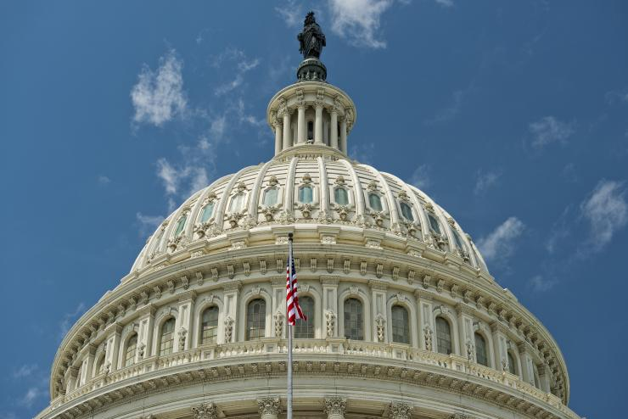
LEGISLATIVE UPDATE

Slide 47
WHAT’S THE LATEST FROM CAPITOL HILL?
House & Senate FY17 Appropriations
Both the House and Senate Labor, HHS, Education, and Related Agencies Appropriations Committees have received requests from Members of Congress seeking a delay in implementation of the GE regulations.
The House version seeks a six month delay in implementation, while the Senate version once again seeks to prohibit the implementation of GE until two years after completion of the next reauthorization of the HEA.
47th Annual Northwest Career Colleges Federation Conference
Thursday, May 19, 2016

Slide 48


WHAT’S THE LATEST FROM CAPITOL HILL?
House & Senate HEA Reauthorization
House and Senate Education Committee Leaderships have indicated that they are almost finished with drafts of several different portions (Titles) of what will ultimately be a less than comprehensive HEA Reauthorization bill.
Given the time constraints heading into the November election, the Committees are focused on advancing a Regulatory Reform and Relief package of amendments to HEA. They have assured us that GE will be included in the package.
47th Annual Northwest Career Colleges Federation Conference
Thursday, May 19, 2016

Slide 49


TOM E. NETTING
Mr. Netting has more than 25 years of experience working in government relations and public policy on matters involving higher education and workforce development, elementary and secondary education, healthcare, veterans affairs, and the procurement of federal appropriations.
Throughout his professional career Tom has held positions as a regulator, an activist, and an administrator.
However, the term which he believes fits him best is advocate – because he believes in the issues and the interests of his clients. It is this drive and passion for what he does which makes Tom one of leaders in his field in Washington.
Email: Tom.Netting@Akerman.com
Phone: (202) 824-1724

